Slide 1
Chi-Square Test

Slide 2
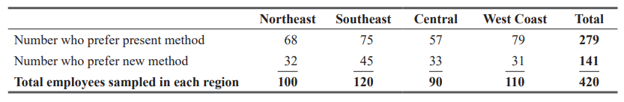
CHI-SQUARE AS A TEST OF INDEPENDENCE
Many times, managers need to know whether the differences they observe among several sample proportions are significant or only due to chance.
Contingency Tables
Suppose that in four regions, the National Health Care Company samples its hospital employees’ attitudes toward job-performance reviews. Respondents are given a choice between the present method (two reviews a year) and a proposed new method (quarterly reviews). A table, which illustrates the response to this question from the sample polled, is called a contingency table.

Slide 3
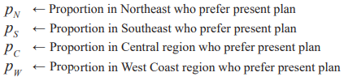

Observed and Expected Frequencies
Suppose we now symbolize the true proportions of the total population of employees who prefer the present plan as
Using these symbols, we can state the null and alternative hypotheses as follows:

Slide 4
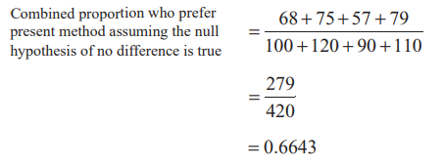
If the null hypothesis is true, we can combine the data from the four samples and then estimate the proportion of the total workforce (the total population) that prefers the present review method:
Using 0.6643 as the estimate of the population proportion we can estimate the number of sampled employees in each region whom we would expect to prefer each of the review methods.

Slide 5
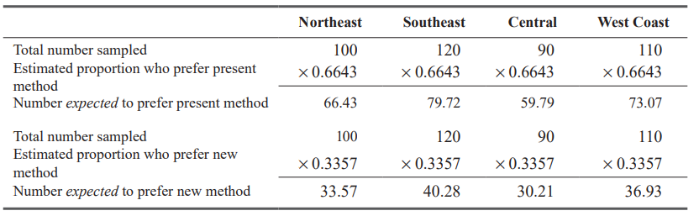
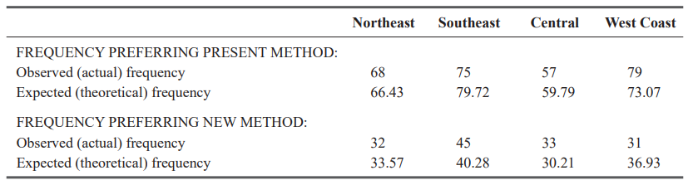

Slide 6
To test the null hypothesis, we must compare the frequencies that were observed with the frequencies we would expect if the null hypothesis is true.
If the sets of observed and expected frequencies are nearly alike, we can reason intuitively that we will accept the null hypothesis.
If there is a large difference between these frequencies, we may intuitively reject the null hypothesis and conclude that there are significant differences in the proportions of employees in the four regions preferring the new method.

Slide 7
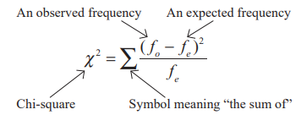
The Chi-Square Statistic
To go beyond our intuitive feelings about the observed and expected frequencies, we can use the chi-square statistic, which is calculated this way:
Numerically, the calculations are easy to do using a table.

Slide 8
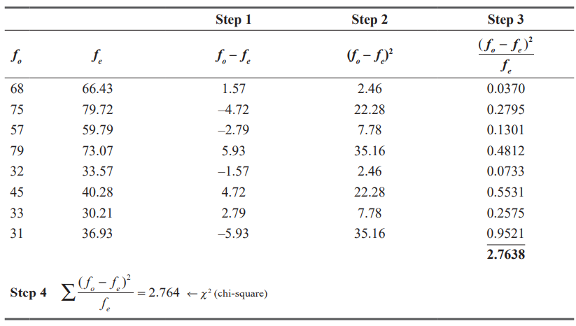

Slide 9
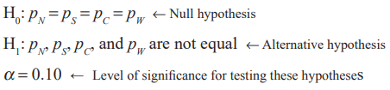
Using the Chi-Square Test
To use the chi-square test, we must calculate the number of degrees of freedom in the contingency table by applying the Equation
If the company wants to test the null hypothesis at the 0.10 level of significance, the problem can be summarized:

Slide 10
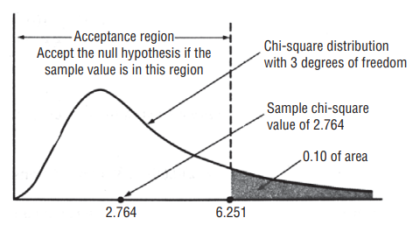
Because our contingency table for this problem has two rows and four columns, the appropriate number of degrees of freedom is 3.
The tabulated value of the chi-square statistic for degrees of freedom is 3 and the level of significance 0.10 is 6.251.
Since the calculated value is less than the tabulated value the difference is not significant and the null hypothesis is accepted.

Slide 11
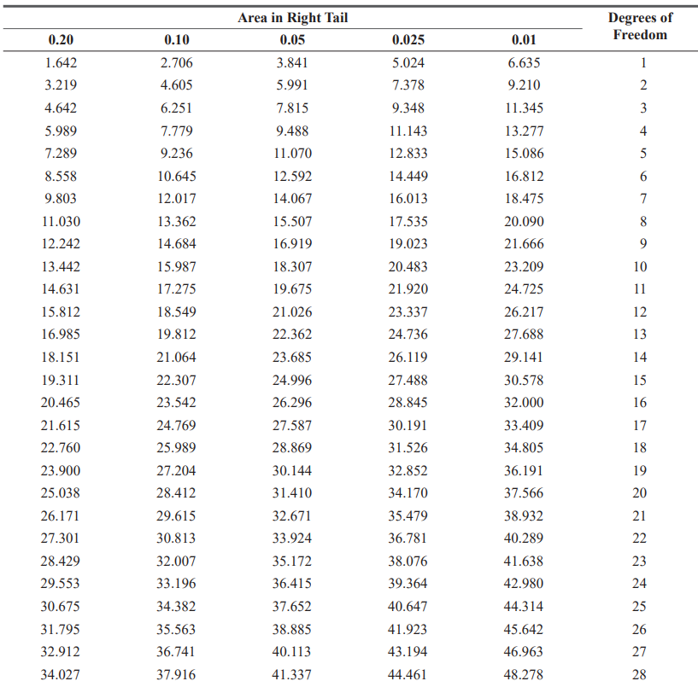

Slide 12


Expected frequency for contingency tables with more than two rows:

Slide 13
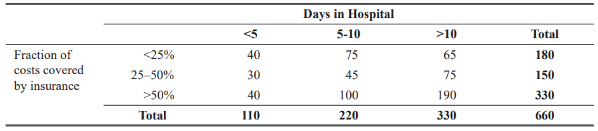
Mr. George McMahon, president of National General Health Insurance Company, is opposed to national health insurance. He argues that it would be too costly to implement, particularly since the existence of such a system would, among other effects, tend to encourage people to spend more time in hospitals. George believes that lengths of stays in hospitals are dependent on the types of health insurance that people have. He asked Donna McClish, his staff statistician, to check the matter. Donna collected data on a random sample of 660 hospital stays and summarized them in the table:

Slide 14
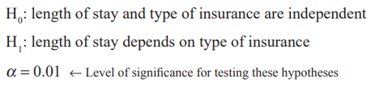
Donna wishes to test the hypotheses:

Slide 15
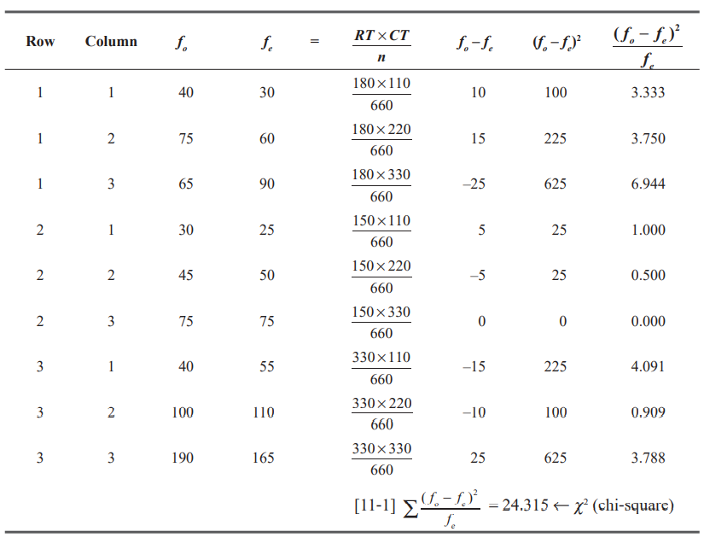

Slide 16
Tabulated value for chi-square with 4 degrees of freedom and 0.01 level of significance is 13.277.
Null hypothesis? Accept/Reject

Slide 17
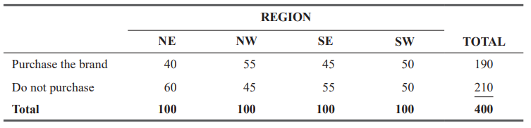
A brand manager is concerned that her brand’s share may be unevenly distributed throughout the country. In a survey in which the country was divided into four geographic regions, a random sampling of 100 consumers in each region was surveyed, with the following results:

Slide 18
Develop a table of observed and expected frequencies for this problem.
Calculate the sample χ² value.
State the null and alternative hypotheses.
At α = 0.05, test whether brand share is the same across the four regions.

Slide 19
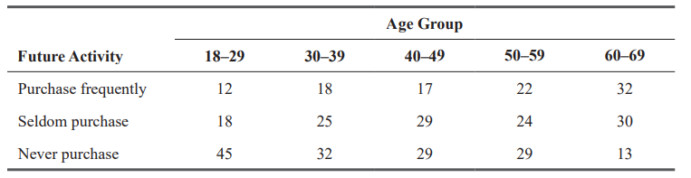
An advertising firm is trying to determine the demographics for a new product. They have randomly selected 75 people in each of 5 different age groups and introduced the product to them. The results of the survey are given in the following table:

Slide 20
Develop a table of observed and expected frequencies for this problem.
Calculate the sample χ² value.
State the null and alternative hypotheses.
At α = 0.01, should the null hypothesis be rejected?

Slide 21
Precautions about Using the Chi-Square Test
To use a chi-square hypothesis test, we must have a sample size large enough to guarantee the similarity between the theoretically correct distribution and our sampling distribution.
When the expected frequencies are too small, the value of χ2 will be overestimated and will result in too many rejections of the null hypothesis.
To avoid making incorrect inferences from χ2 hypothesis tests, follow the general rule that an expected frequency of less than 5 in one cell of a contingency table is too small to use.

Slide 22
CHI-SQUARE AS A TEST OF GOODNESS OF FIT: TESTING THE APPROPRIATENESS OF A DISTRIBUTION
The chi-square test can also be used to decide whether a particular probability distribution, such as the binomial, Poisson, or normal, is the appropriate distribution.
This is an important ability because as decision makers using statistics, we will need to choose a certain probability distribution to represent the distribution of the data we happen to be considering.
The chi-square test enables us to ask this question and to test whether there is a significant difference between an observed frequency distribution and a theoretical frequency distribution.

Slide 23
Assumptions
There should be one categorical variable (i.e., the variable can be dichotomous, nominal, or ordinal).
Observations should be independent.
The groups of the categorical variable must be mutually exclusive.
There must be at least 5 expected frequencies in each group of the categorical variable.

Slide 24
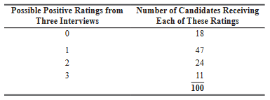
Calculating Observed and Expected Frequencies
Suppose that the Gordon Company requires that college seniors who are seeking positions with it be interviewed by three different executives. This enables the company to obtain a consensus evaluation of each candidate. Each executive gives the candidate either a positive or a negative rating. Table contains the interview results of the last 100 candidates.

Slide 25
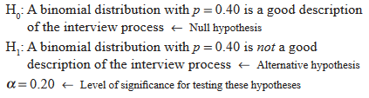
For staffing purposes, the director of recruitment for this company thinks that the interview process can be approximated by a binomial distribution with p = 0.40, that is, with a 40 percent chance of any candidate receiving a positive rating on any one interview.
We can begin by determining what the binomial probabilities would be for this interview situation.

Slide 26
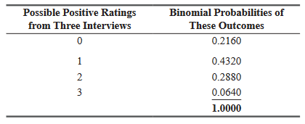
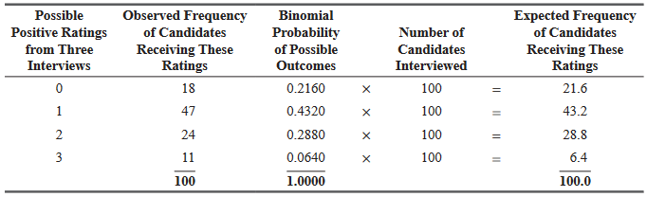
Now we can use the theoretical binomial probabilities of the outcomes to compute the expected frequencies.

Slide 27
Determining Degrees of Freedom in a Goodness-of-Fit Test
Begin with degree of freedom = number of classes-1
To solve a goodness-of-fit problem we may be forced to impose additional restrictions on the calculation of the degrees of freedom.
First employ the (k – 1) rule and then subtract an additional degree of freedom for each population parameter that has to be estimated from the sample data.

Slide 28
At the 0.10 level of significance, can we conclude that the following 400 observations follow a Poisson distribution with λ = 3?

Slide 29
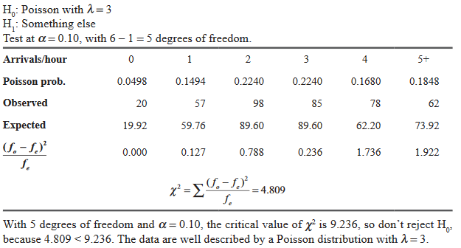

Slide 30
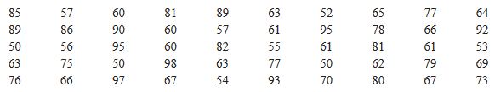
After years of working at a weighing station for trucks, Jeff Simpson feels that the weight per truck (in thousands of pounds) follows a normal distribution with μ = 71 and σ = 15. In order to test this assumption, Jeff collected the following data one Monday, recording the weight of each truck that entered his station.

Slide 31
If Jeff used a chi-square goodness-of-fit test on these data, what would he conclude about the trucks’ weight distribution? Use a 0.10 level of significance.
Hint: use 5 equally probable intervals

Slide 32
